Slide 1


OSLO toolchain
Welkom!
27 april 2022

Slide 2

Welcome and roundtable

Slide 3
Building Data standards
Semantic web
Governance
Cocreation
Workshops
Publishing tools
Toolchain
Technical agreements
Vocabularies, application profiles
Transparency
Multilingual, persistent identifiers
Online consultation
Facilitate engagement
Trust & Reuse
conformance

Slide 4
Editors
Person that
Can write “formal” statements in vocabularies & application profiles (linguistic skills)
Can organize information in a data model (structuring skills)
Can explain data model issues in a webinar (communication skills)
Can write & execute simple software code (software developer skills)

Slide 5


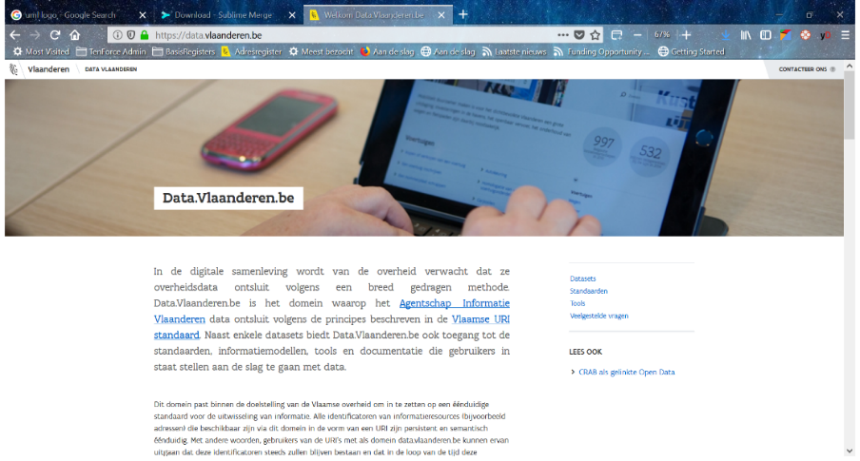


Automation
Continuous-integration
Automated reflection
Source data
Publishing configuration
Derived artifacts
Ready to publish

Slide 6
Setup
Thema repository
A repository which contains the content of one or more data standards
OLSOthema-*
Find all: https://github.com/topics/oslothema
Publication environment repository
A repository associated with a publication environment
Data.vlaanderen.be; *
Generated repository
The repository that contains the result of the processing.
For every publication environment there is one generated repository.
Data.vlaanderen.be-generated; *

Slide 7
Thema repository
Draft
Candidate
Standard release x.y
Draft x.z
commit
tag
no specific governance imposed
Pull request/ merges

Slide 8
Data modeling guidelines
UML is master language for the editor
Annotated to generate a predicable Semantic Web representation
The semantic web representation is normative document
https://github.com/Informatievlaanderen/OSLOthema-toolchainTestbed

Slide 9
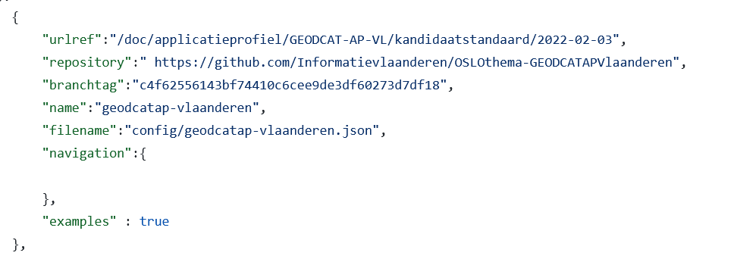
Publication environment
Contains the list of publication points to be published.

Slide 10
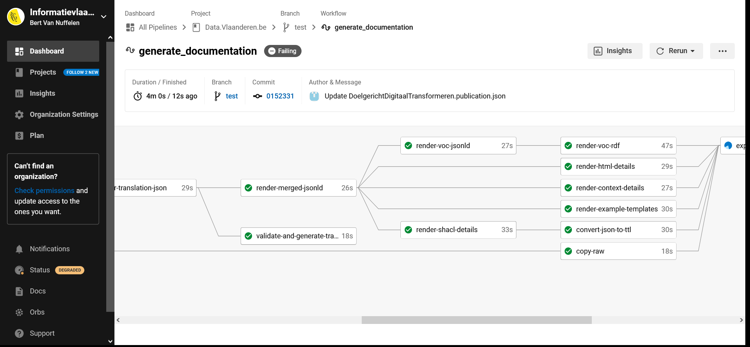
Automation
aggregation
Artifact generation

Slide 11
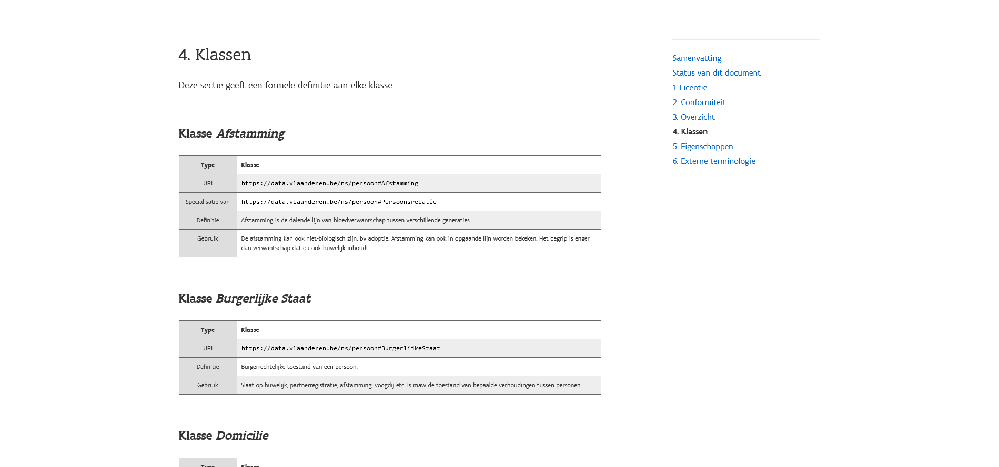
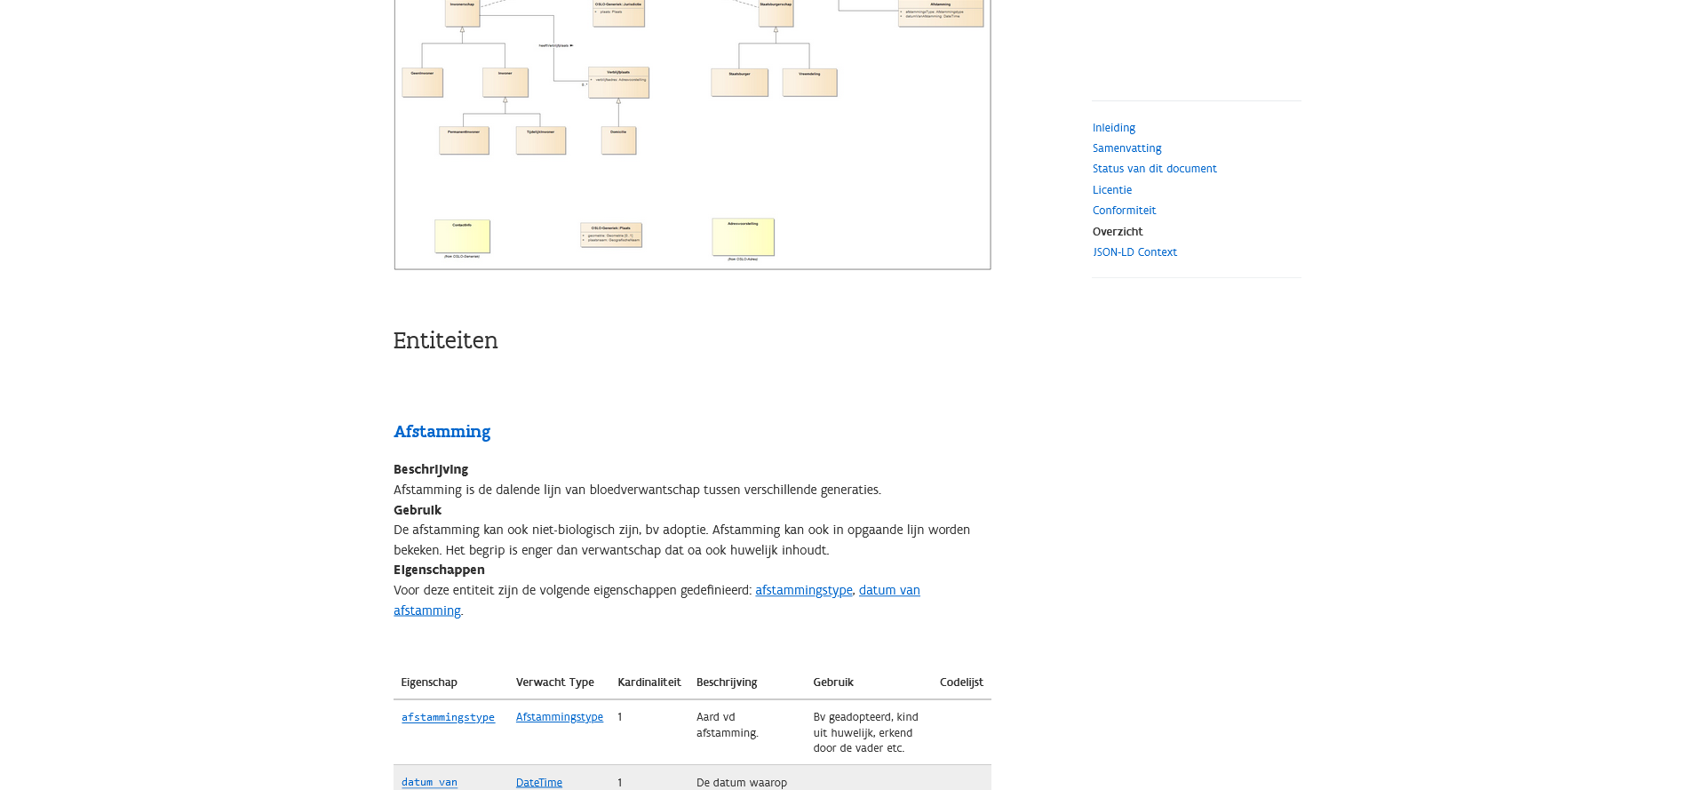
Representation flexibility
vocabulary
Application profile

Slide 12
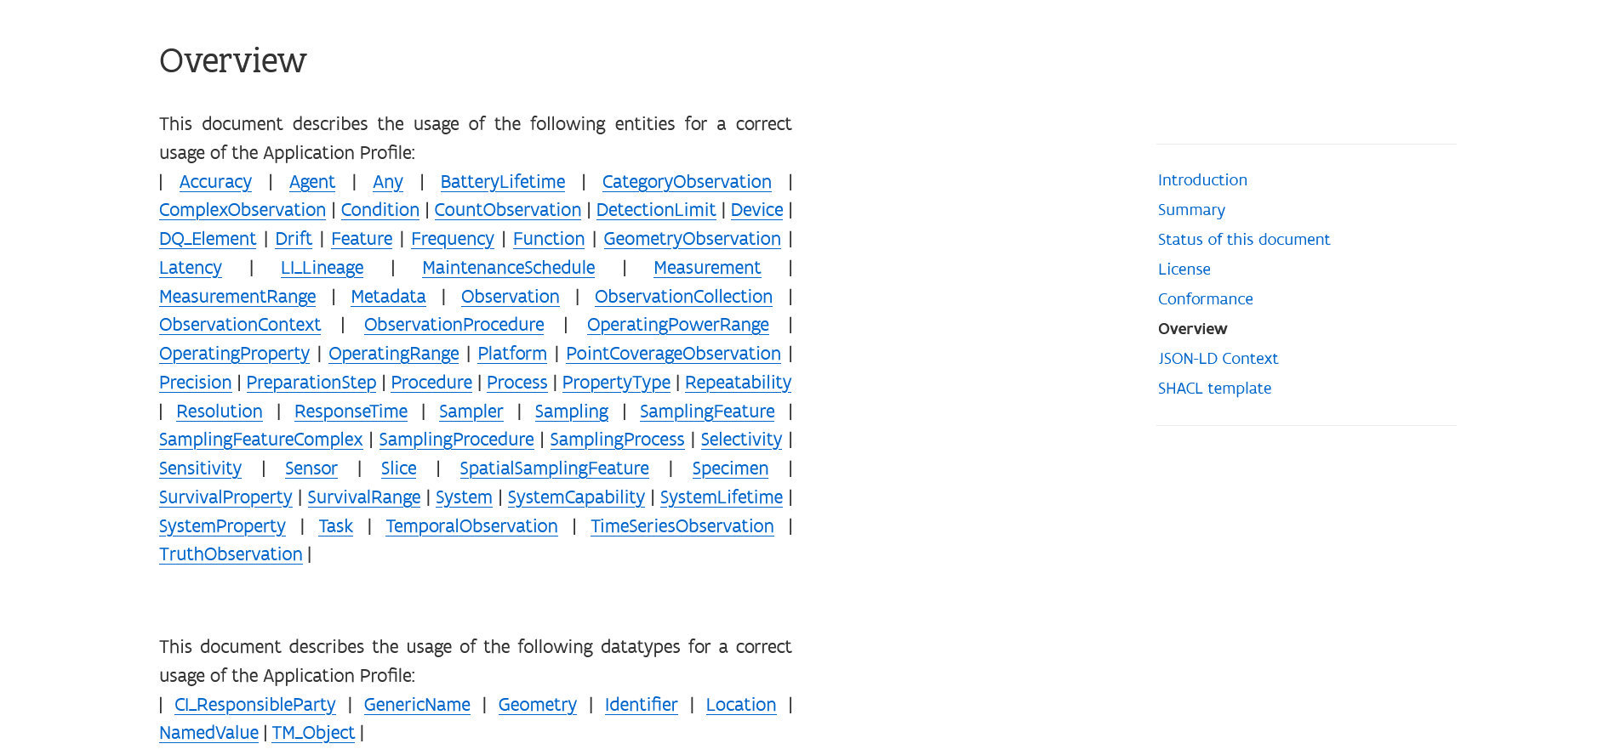
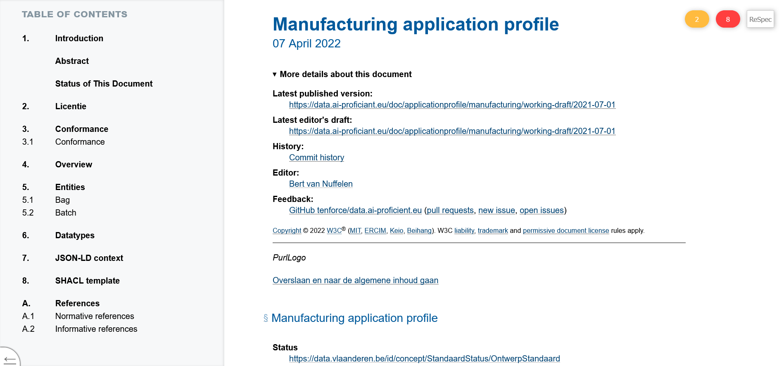
Representation flexibility
Application profile in other language and domain
Different look and feel

Slide 13
Generated artifacts
html (simple css embedding + SPA view approach)
RDF vocabulary
JSON-LD contexts
SHACL templates
Examples templates (json)
Translation support
xsd representation (experimental)

Slide 14
Publication and supportive tools
Webservice and proxies to interprete the generated website
Content negotiation for PURI support
SHACL validator (ISA testbed variant)
Experimental playground

Slide 15
Publication and supportive tools
Webservice and proxies to interprete the generated website
Content negotiation for PURI support
SHACL validator (ISA testbed variant)
Experimental playground

Slide 16
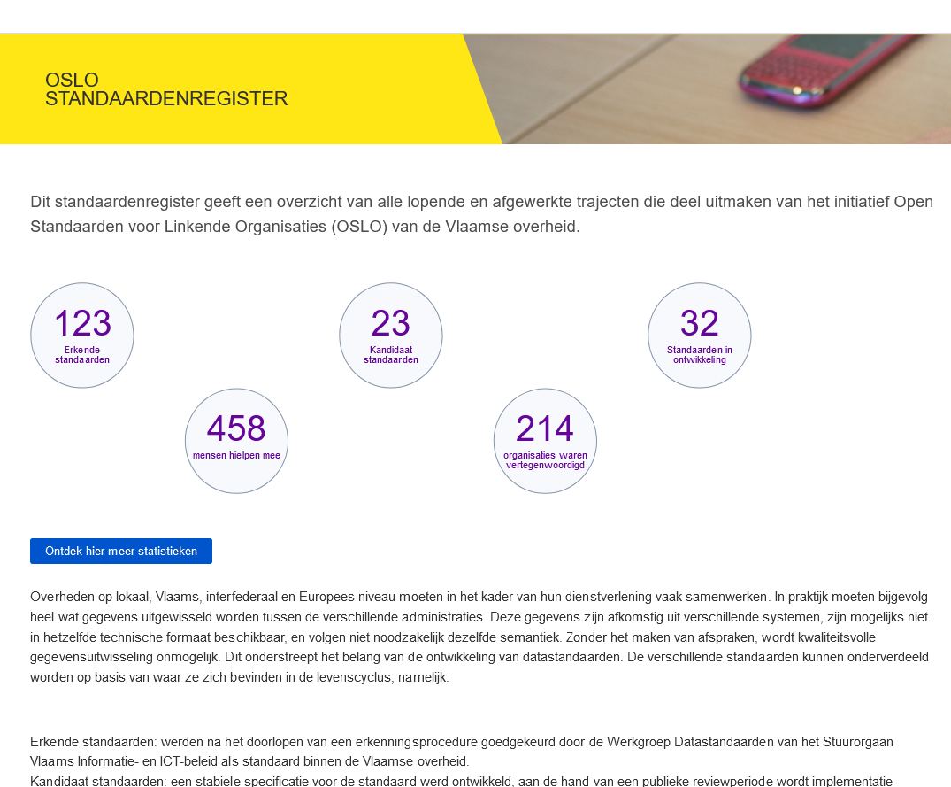
Registry of data standards
https://data.vlaanderen.be/standaarden/

Slide 17
prerequisites
GitHub based (but adaptable to any git environment)
Deployment is done by copying template repositories and then configuration
(minor) UML tool is sole commercial bottleneck

Slide 18

Questions ?

Slide 19
Thank You!

